Slide 1
WHAT ARE THE MODELS?
Overview of the types of support valued
by working caregivers

Slide 2
What are the models?
The type of programs & benefits employers currently use to support caregivers in the workforce vary widely, but most fall into one of three categories:
Flexibility and breaks
Information and support
Financial support and resources

Slide 3
Flexibility and Breaks — Leave
Employers can make a remarkable difference by providing temporary “time outs” from jobs.
Most employers are obligated to provide 12 weeks of unpaid family leave to their employees.
Women and racial minorities are more likely to have caregiving responsibilities, but also tend to have less access, indicating that provision of flexible work options is key to sustaining diversity.
Solutions in this Model:
  Make leave options widely available
  Provide options for extended leave
  Provide options for paid leave
  Foster a supportive environment
Most employers offer strong communications that family connections matter.
Should Employers Care About Employees as People, Considering How Work Demands Can Intersect with Family Demands and Respond Accordingly? This Graph Shows How Strongly This Message is Communicated by Top Leadership in American Companies
Notes:
Figures in this chart are based on the 2014-2015 Talent Management Study.

Slide 4
Flexibility and Breaks — Schedules
Employers now offer far more flexibility than they did in the past.
When jobs are harmonized and fit with personal and family commitments, positive outcomes can be expected for both employees and employers.
Flexible schedules are more frequently available than flexible locations, and the type of flex that employers may offer will vary. Fewer employers offer reduced work loads, but often this is what working caregivers need, even if it is only a temporary solution.
Solutions in this Model:
  Put flexibility “on the books”
  Encourage discussions of work-life fit
  Approve options that could be a “win-win” for the employee and the employer
  Entertain use on a trial basis
Most employers offer schedule flexibilities to some members of their workforce, and many offer options to all of their workers.
Notes:
Figures in this chart are based on the 2014-2015 Talent Management Study.

Slide 5
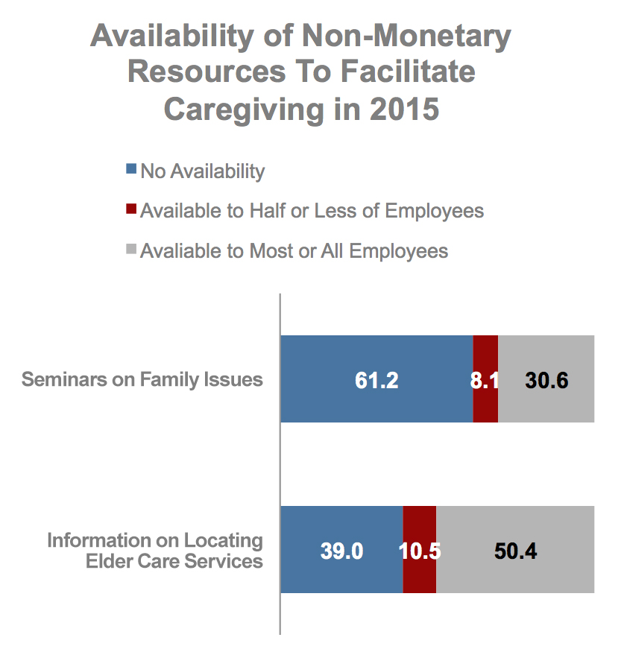
Information and Support
Employers are ideally situated to transmit information concerning a broad array of issues & challenges (as well as solutions & resources) for working caregivers.
Employee assistance programs (EAPs) can help relieve stress & maximize employee engagement by identifying solutions to constraints that may exist on or off the job
Social networks, community connections, and knowledge of external resources can be a low-cost means to help employees find answers to challenges.
Solutions in this Model:
  Explore EAP options and vendors
  Develop “in house” information
  Promote support for and among your working caregivers via events such as
    Brown bag sharing sessions
    Guest speakers or webinars
Most employers offer information to support caregiving needs
Notes:
Figures in this chart are based on the 2014-2015 Talent Management Study.

Slide 6
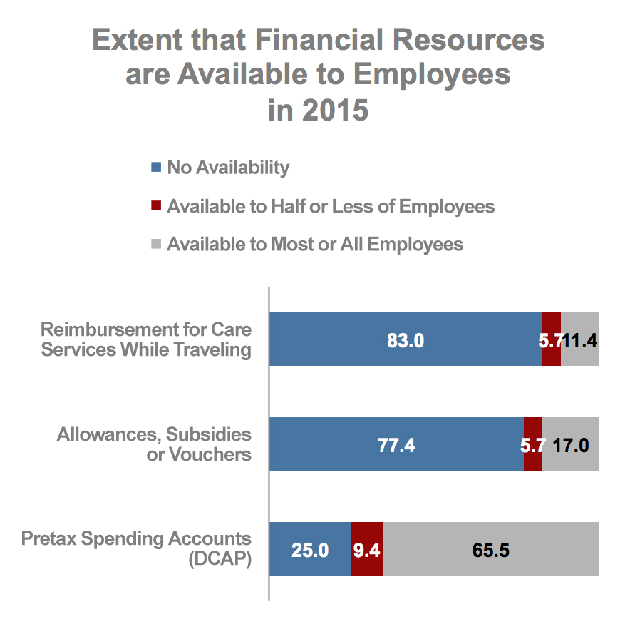
Financial Support and Resources
Employers can alleviate stress, time constraints, and monetary strain by providing financial supports and caregiving resources.
Focusing on the relief of financial constraints, with its subsequent impact on employee loyalty and workplace engagement, can be one of the most effective means of addressing caregiving dilemmas.
Solutions in this Model:
  Offer direct financial assistance, such as dependent care flexible spending accounts, reimbursement for care services, or allowances, subsidies, or vouchers.
  Directly hire care workers or provide back-up care through an external provider
  Provide information and support through external providers
Most employers offer at least
one financial resource to
support caregiving
Notes:
Figures in this chart are based on the 2014-2015 Talent Management Study.

